Slide 1
Response to BET bromodomain inhibition in ovarian cancer
Anil

Slide 2
Targeted therapy and drug combinations
Many targeted agents for cancer therapy are approved and even more are in the pipeline.
Most (not all) agents target soluble kinase molecules, RTK, cell surface molecules.
Drug resistance eventually emerges leading to rapid progression of metastatic disease
Immediate solution: Combine targeted drugs to block different escape routes
Target different signaling pathways, combining targeted therapies with conventional chemotherapy or target other biological processes such as epigenetic regulation.

Slide 3
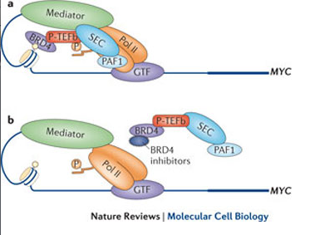
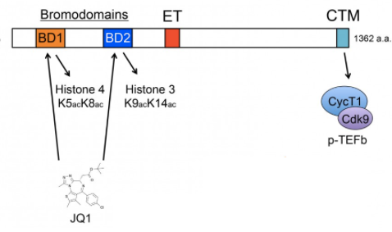
Targeting epigenetic regulation for cancer therapy : BET bromodomain inhibition
BRD4 binds to acetylated histones and recruits the transcription elongation factor (p-TEFP) to release DNA and initiate transcription elongation.
BRD4 binds to histones cooperatively particularly at super-enhancer sites, which regulate key mitotic genes particularly c-Myc (and others) (Loven et al 2013).
JQ1 directly targets the bromodomain protein BRD4, which marks select genes including c-Myc on mitotic chromatin.
Inhibition of BRD4 with JQ1 downregulates the c-Myc mRNA transcription and leads to G1 cell cycle arrest in diverse tumor types (Delmore et al., 2011; Loven et al., 2013; Puissant et al., 2013).
(Luo et al 2012)

Slide 4
BRD4 inhibition as a potential therapy strategy
Tested in diverse cancer types
1. Hematological malignancies (Delmore et al.2011 and others)
-Effective in most blood cancers tested for the drug
-Myc level is downregulated in all cases.
2. Neuroblastoma (Puissant et al 2013)
-MYCN amplified cells are more sensitive
3. GBM (Shimamura - 2013)
-Effective in genetically diverse GBM tumors.
-Bcl-xl transcription may be affected by the drug (Not c-Myc).
4. Lung adenocarcinoma (Lockwood et al 2012)
-Most cell lines are resistant
-FOSL1 expression is reduced in response to JQ1
5. Prostate cancer (Asangani et al 2014)
-Disruption of physical AR-BRD4 interaction, inhibition of AR recruitment to its
target loci and inhibition of AR mediated transcription.

Slide 5
Resistance and drug combinations?
-Mechanisms of resistance to JQ1.
-Design of combination therapies involving JQ1.
One combination has been reported (JQ1+ GSI) to overcome NOTCH inhibitor resistance in T cell acute lymphoblastic leukemia. (Knochel et al 2014)
-For nominating effective combinations with kinase inhibitors, we need to understand the pathway level changes in response to the drug.

Slide 6
The impact of BET bromodomain inhibition on signaling pathways?
-BET bromodomains regulate expression of key genes such as c-Myc
-c-Myc controls expression of thousands of genes.
-The impact of JQ1 on transcription has been profiled in multiple contexts.
-What do we know about the impact of BET bromodomain inhibition on signaling
molecules and phosphoprotein levels
Almost nothing!

Slide 7
Is JQ1 (as a single agent or in combo) effective in ovarian cancer cell lines?
Which pathways are affected (up/down regulated) by the drug?
(3) “Which pathways may be associated with resistance to JQ1" in ovarian cell lines?
(4) Can we nominate a combination to overcome the JQ1 resistance in resistant cell lines?
Can we nominate JQ1 (as a single agent or in combo) as a therapy option in ovarian cancer?

Slide 8
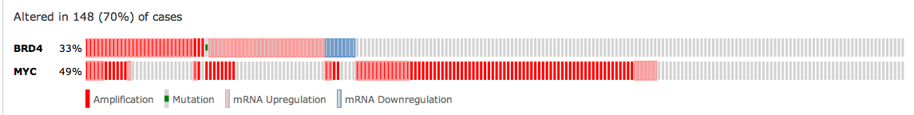
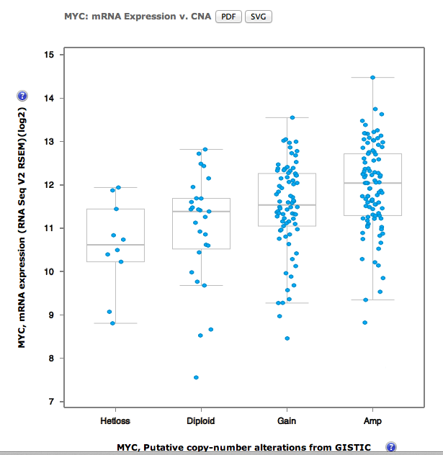
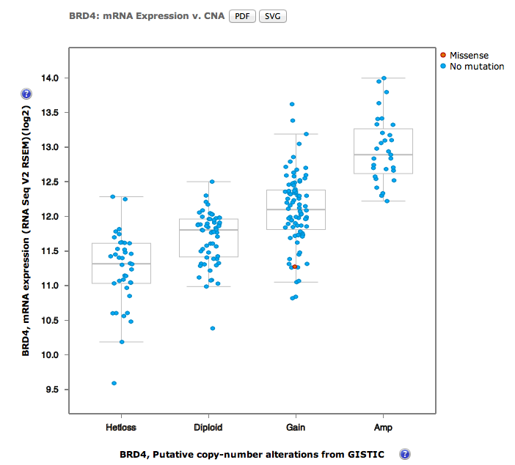
BRD4 and c-MYC alterations are common in ovarian cancer

Slide 9
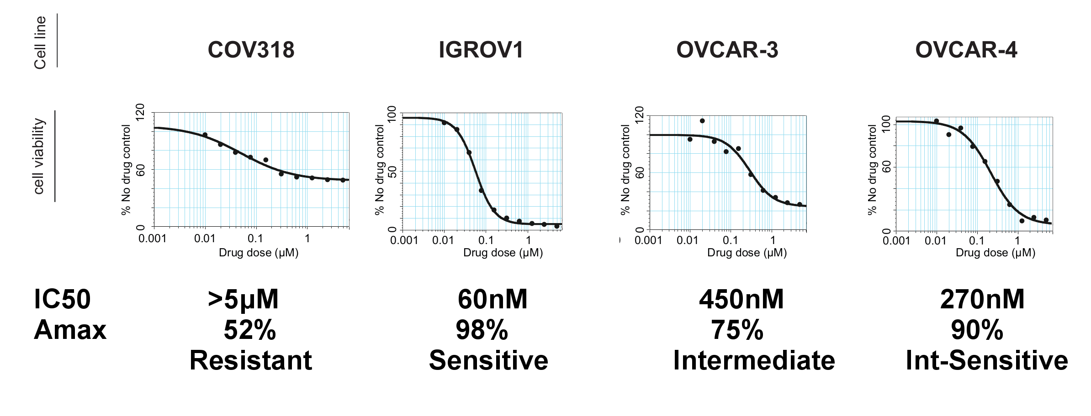
Ovarian cell lines have varying sensitivity to JQ1
-Tested cell viability of ovarian cell lines in response to JQ1.
-Measured viability with Resazurin assay.
-JQ1 doses. 10nM to 5uM.
-Viability measured at day 5.

Slide 10
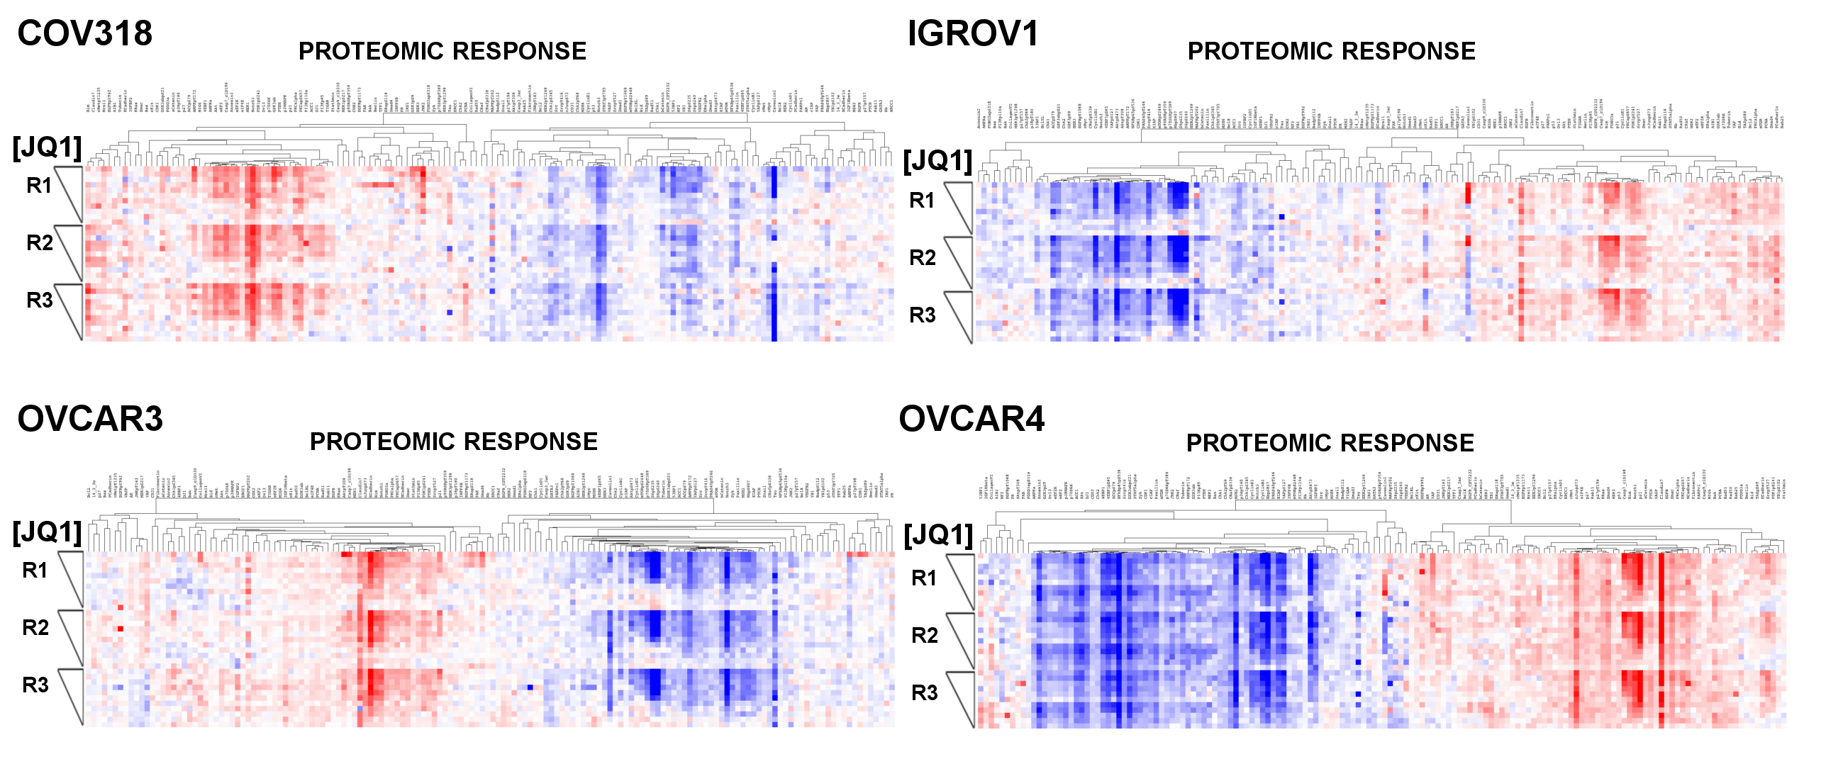
Proteomic response to JQ1
RPPA data is collected in same conditions (i.e. dose response series to JQ1).
151 proteins are measured. 42 phosphoproteins, 109 total protein .
All in triplicates.
Data collected 24hrs after drug treatment

Slide 11
Is JQ1 (as a single agent or in combo) effective in ovarian cancer cell lines?
Which pathways are affected (up/down regulated) by the drug?
(3) “Which pathway(s) may be associated with resistance to JQ1" in ovarian cell lines.
(4) Can we nominate a combination to overcome the JQ1 resistance in resistant cell lines.

Slide 12
Pathway analysis of JQ1 response in ovarian cancer lines
Pathway analysis strategy (Emek)
-Hypothesis/question (Response to JQ1, resistance and potential combinations)
-Observables (e.g., RPPA and phenotypic readouts)
- Pathways map (e.g., Pathway commons-PERA algorithm)
-Statistical criteria for mapping and analysis (Determine the JQ1 dose –
cell/proteomic response relationship)
-Predict and test (Collective associations or causal relations between the observables, predict response to combinations)

Slide 13
Systematic extraction of simplified pathway information from databases: PERA algorithm
Biopax: Demir et al, 2009 Nature Biotech
Pathway Commons: Cerami et al, 2011 Nucl Acid Res.
Determine the pathway relations in already measured proteomic entities.
The RPPA data is coarse compared to the pathway representations in Pathway commons.
Avoid overly complicated paths. Strong reduction algorithm.
Improve representation, add genomic and drug target (PiHelper) data.

Slide 14
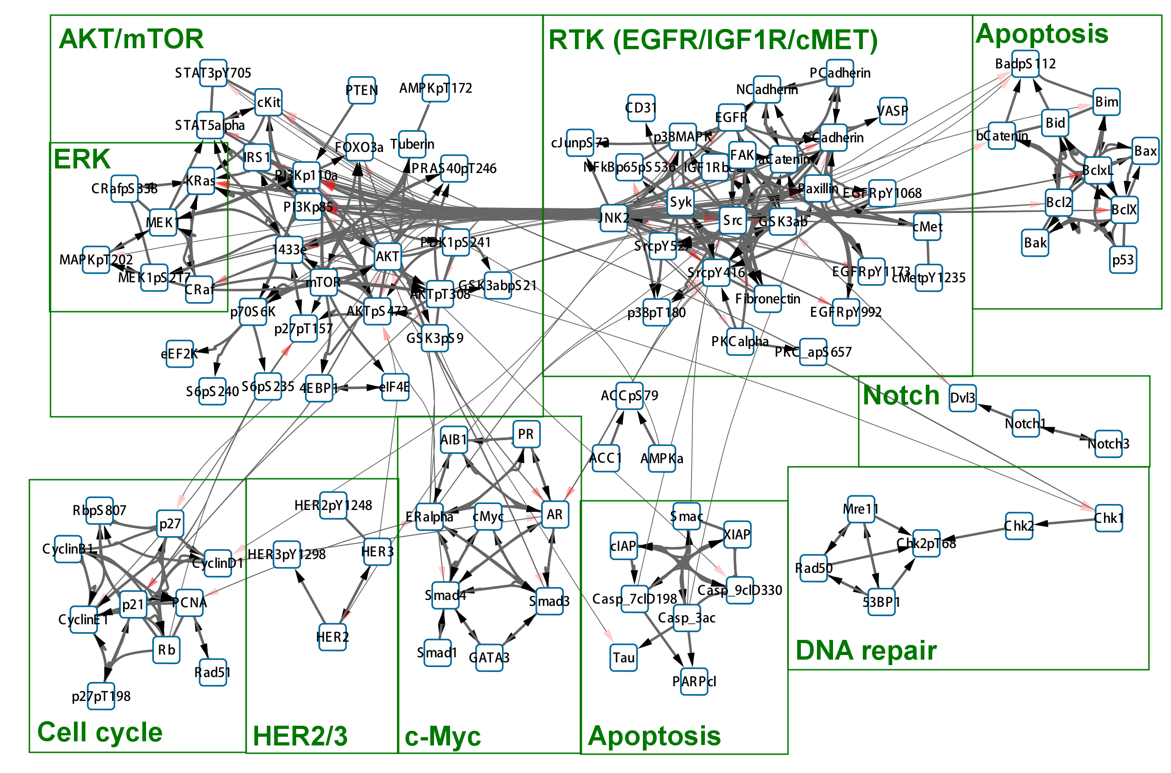
-PERA outcome: We included all complex formation information (i.e., a dense network)
-Run a community based network clustering algorithm to determine clusters (hopefully) enriched by members of distinct pathways.

Slide 15
Mapping proteomic response to pathways
How can we map the proteomic changes to pathways?
We are interested in mapping the proteomic entities that are
influenced by the drug and links perturbation to the phenotypic outcome.
The proteomic response to JQ1 is expected to be dose dependent.
Cell viability response to JQ1 is observed as dose dependent.
Select proteomic entities that have a dose dependent relationship with the phenotypic outcome and map.

Slide 16
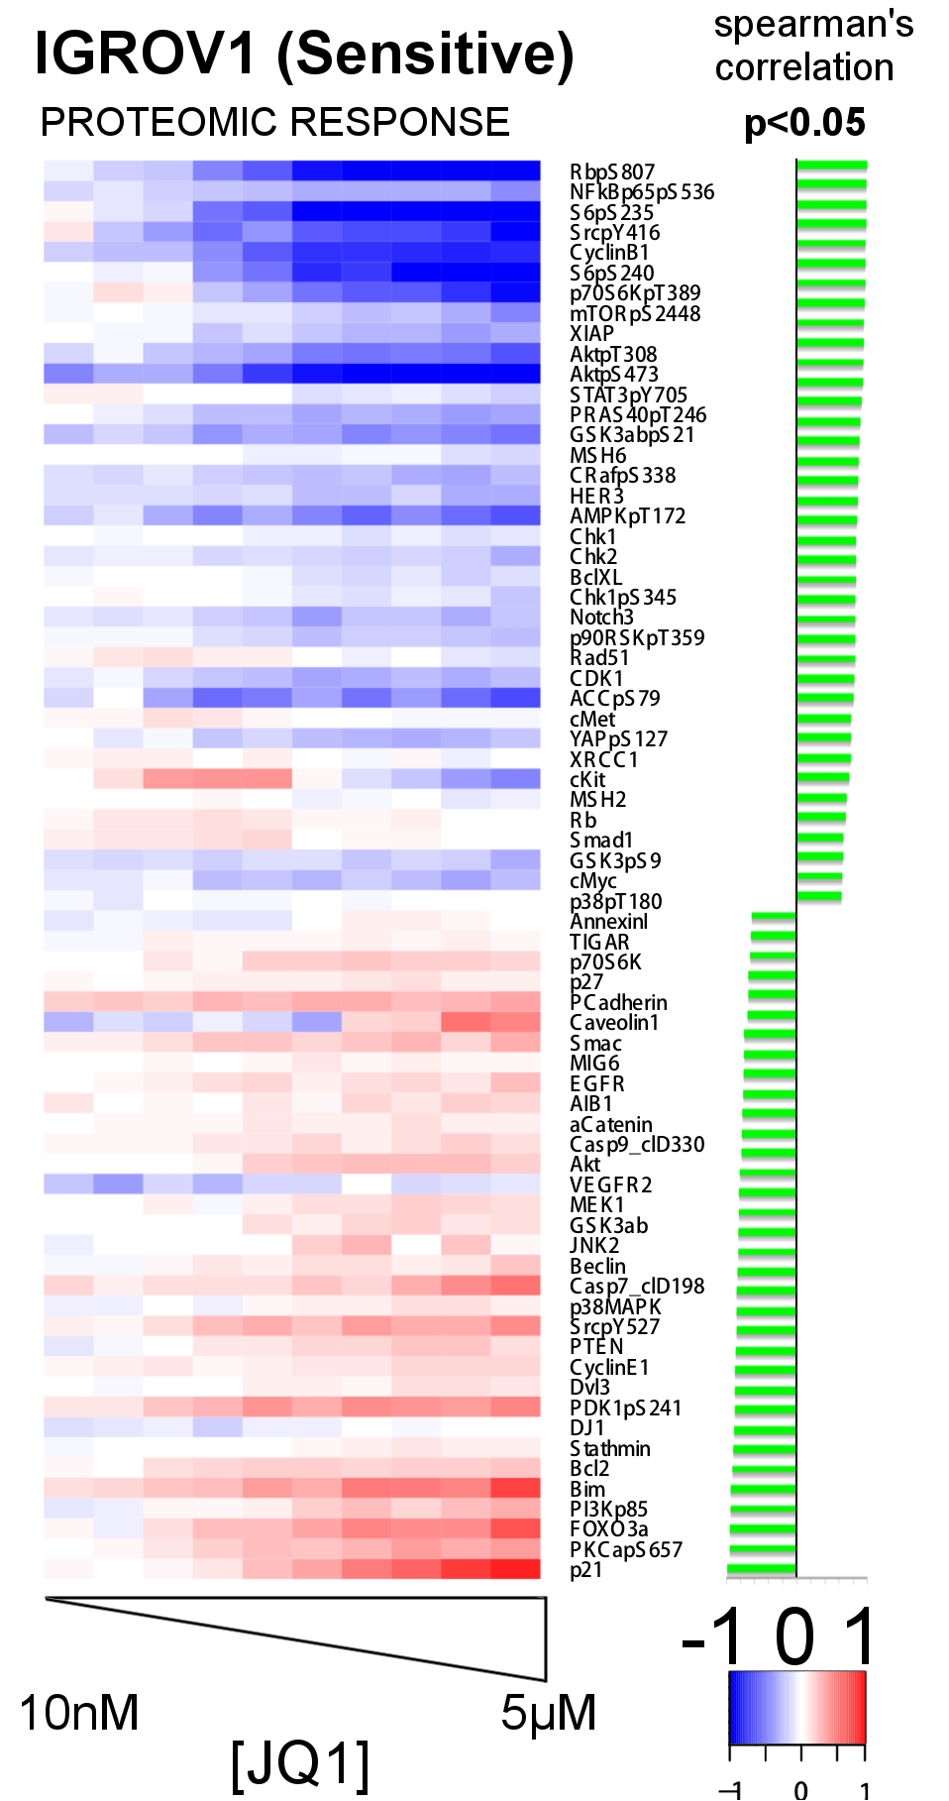
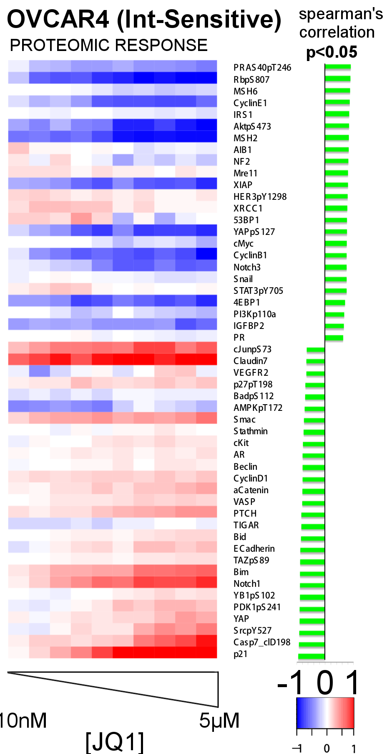
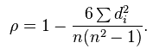
Dose dependent phenotypic and proteomic response
Compute the rank based spearman’s correlation between proteomic readouts and cell viability response.
Select the ones with significant correlation (P<0.05).
cMyc is always significantly correlated with response but not necessarily on top.
P21/CDKN1A is always upregulated in response to JQ1.

Slide 17
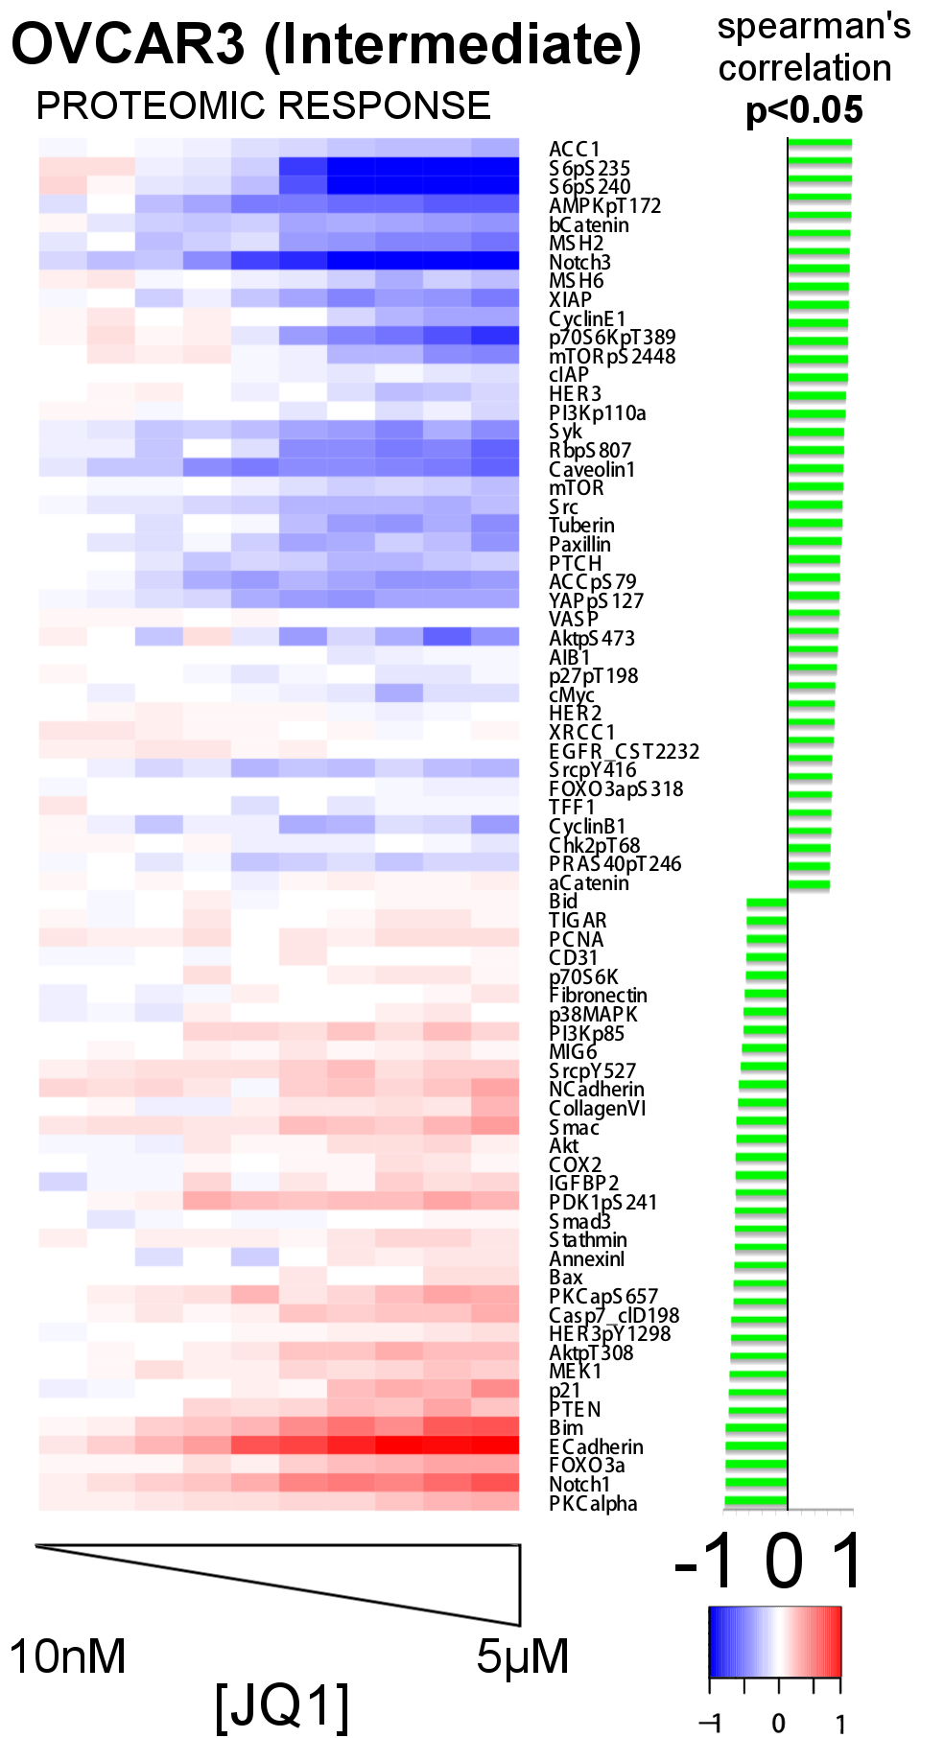
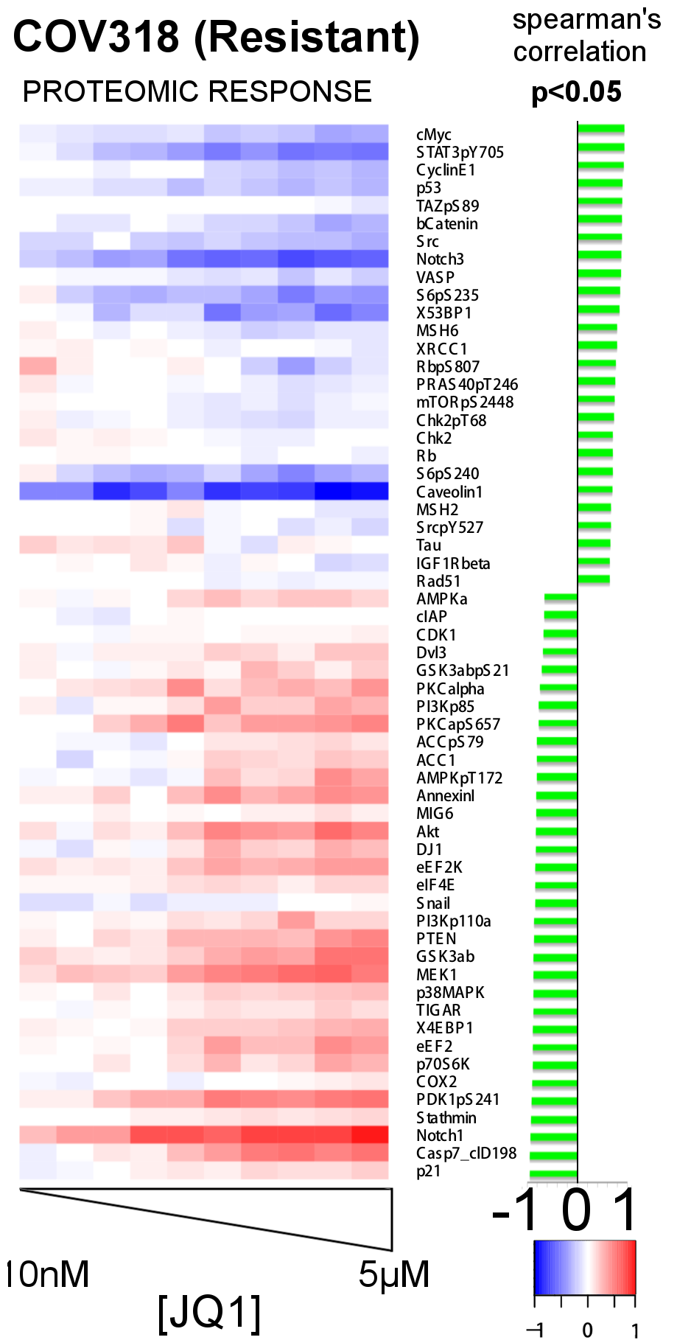
Dose dependent phenotypic and proteomic response

Slide 18
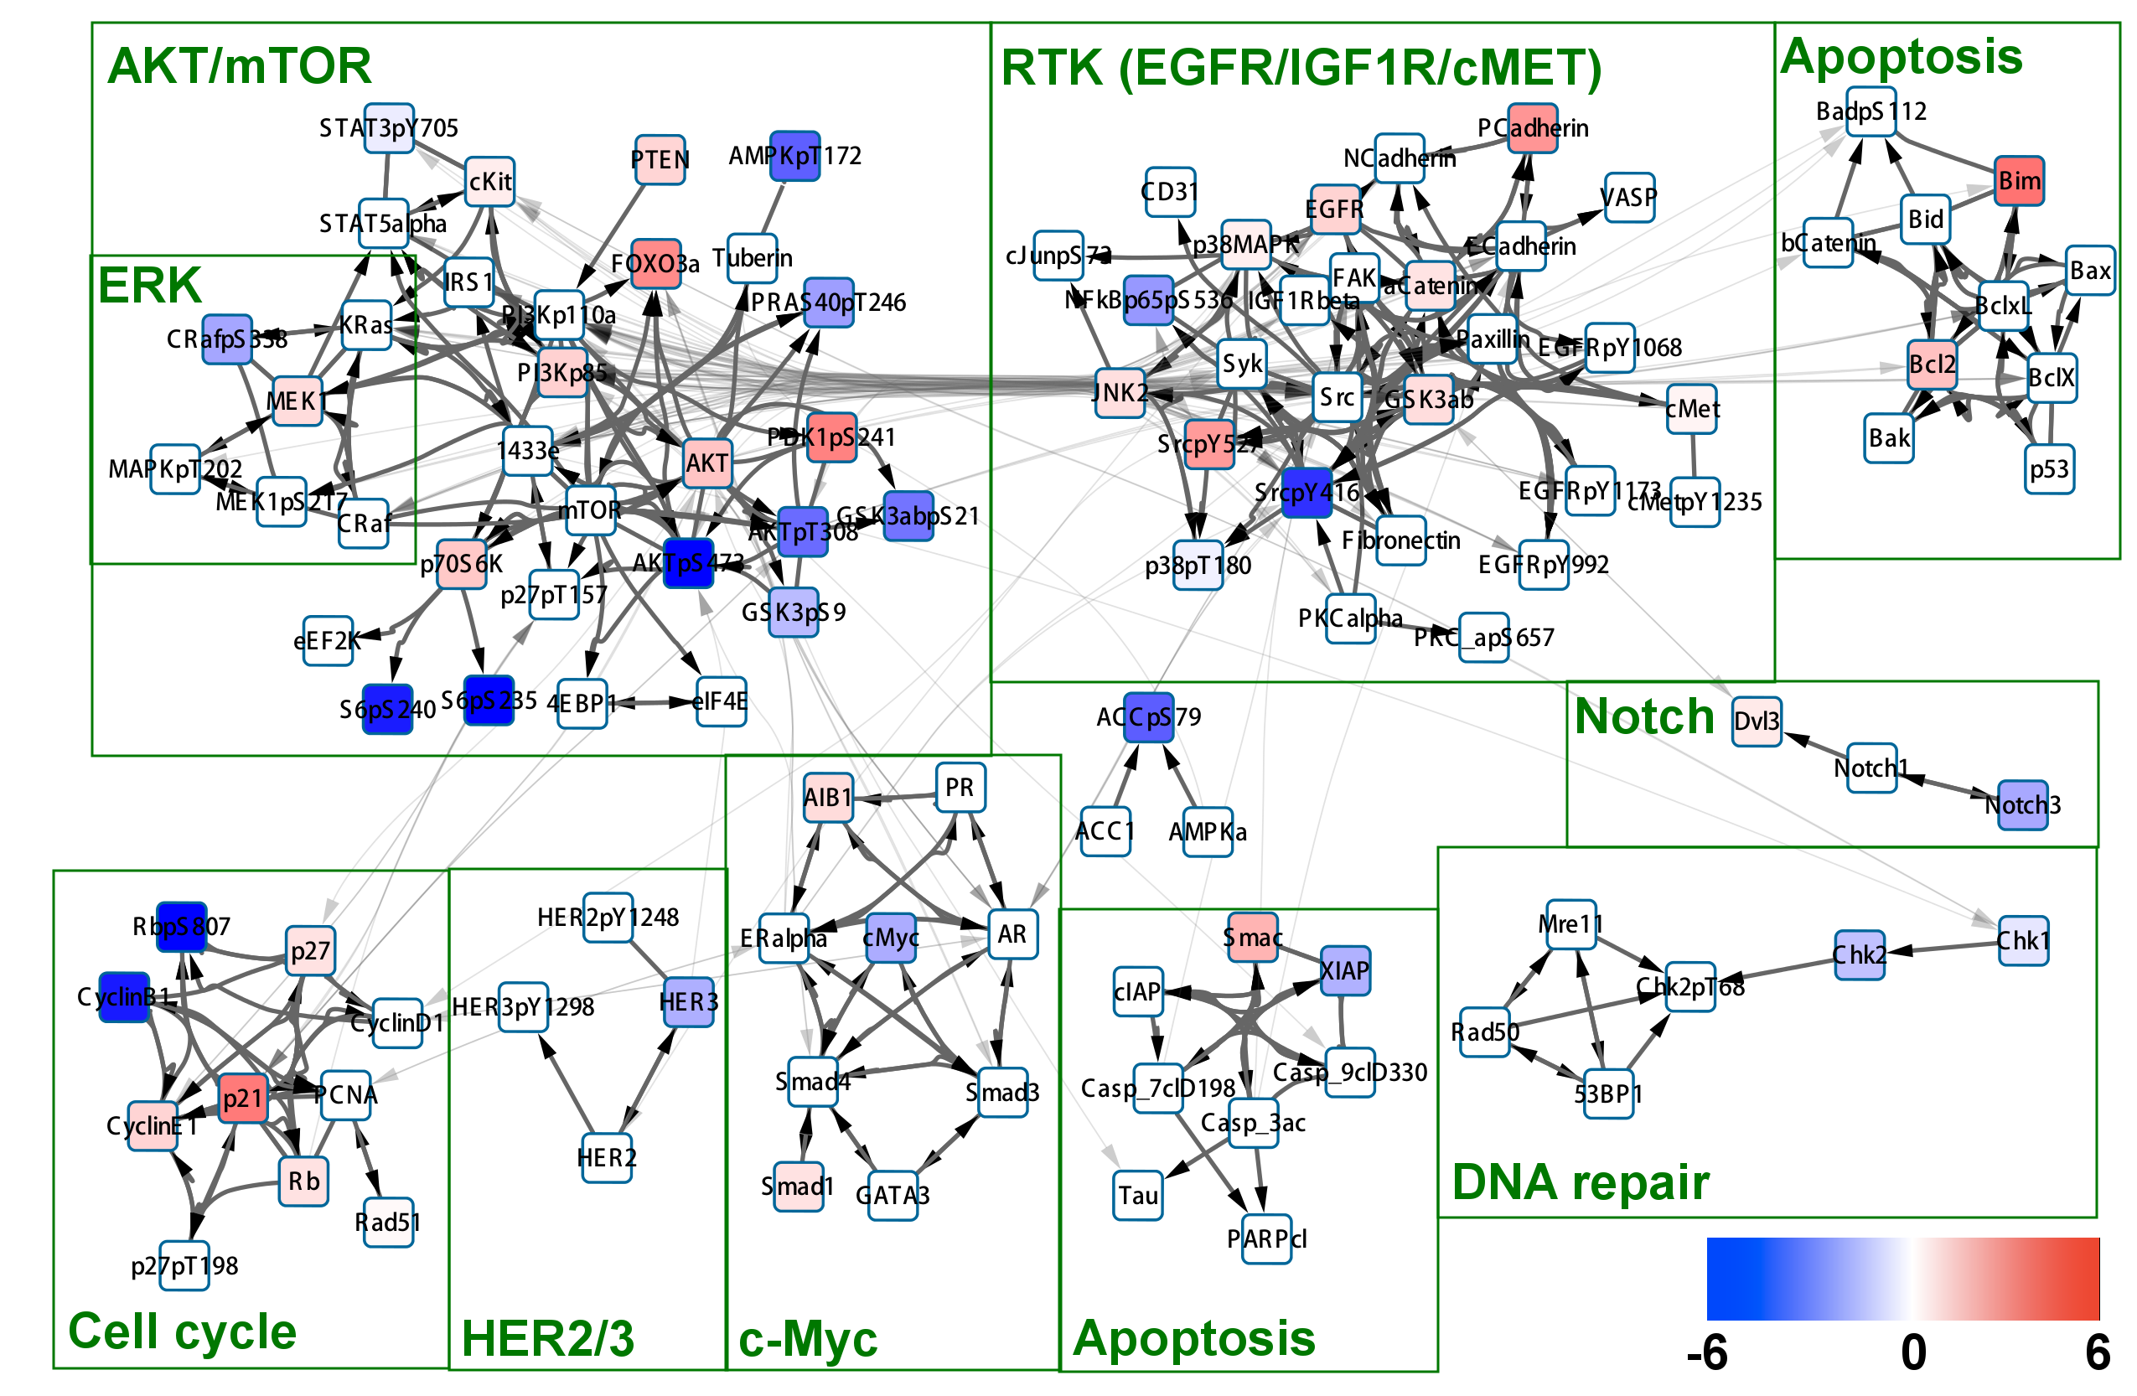
IGROV1-sensitive
Mapped the area under the curve in the dose response curve for each proteomic entity.
Notes:
Many blue nodes in AKT , RTK and cell cycle paths. BIM is down.

Slide 19
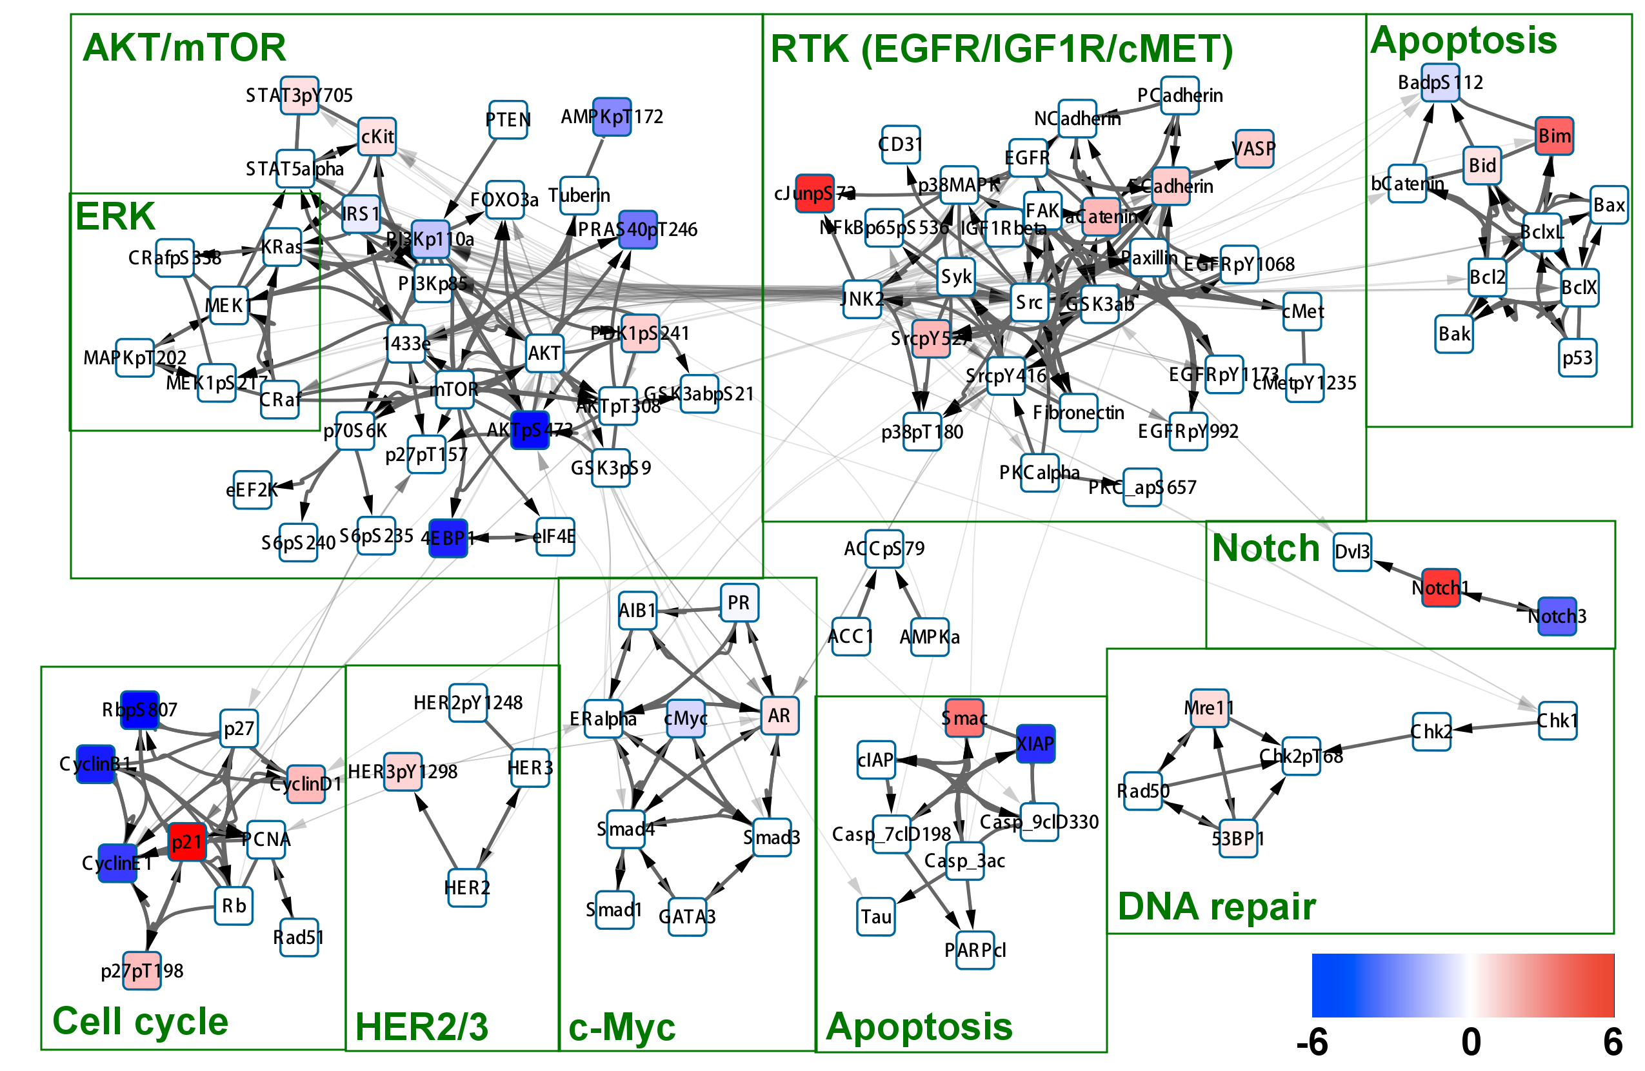
OVCAR4:sensitive
Notes:
AKT is sligtly less deactivated.
RTK pathway is not.
Cell cycle pathway is unchanged.
RTK pathway is not inhibited.
NOTCH pathway is altered.

Slide 20
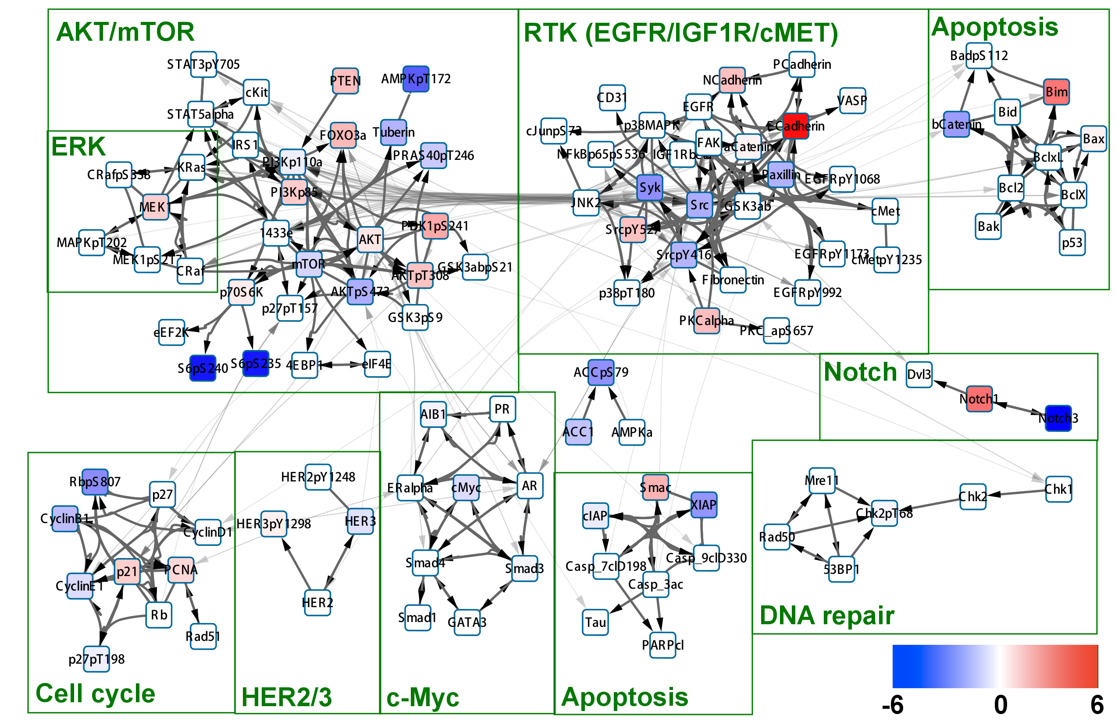
OVCAR3: intermediate
Notes:
AKT is similar to OVCAR4.except AKTpS308 level is up.
No cell cycle effect.
RTK is down.

Slide 21
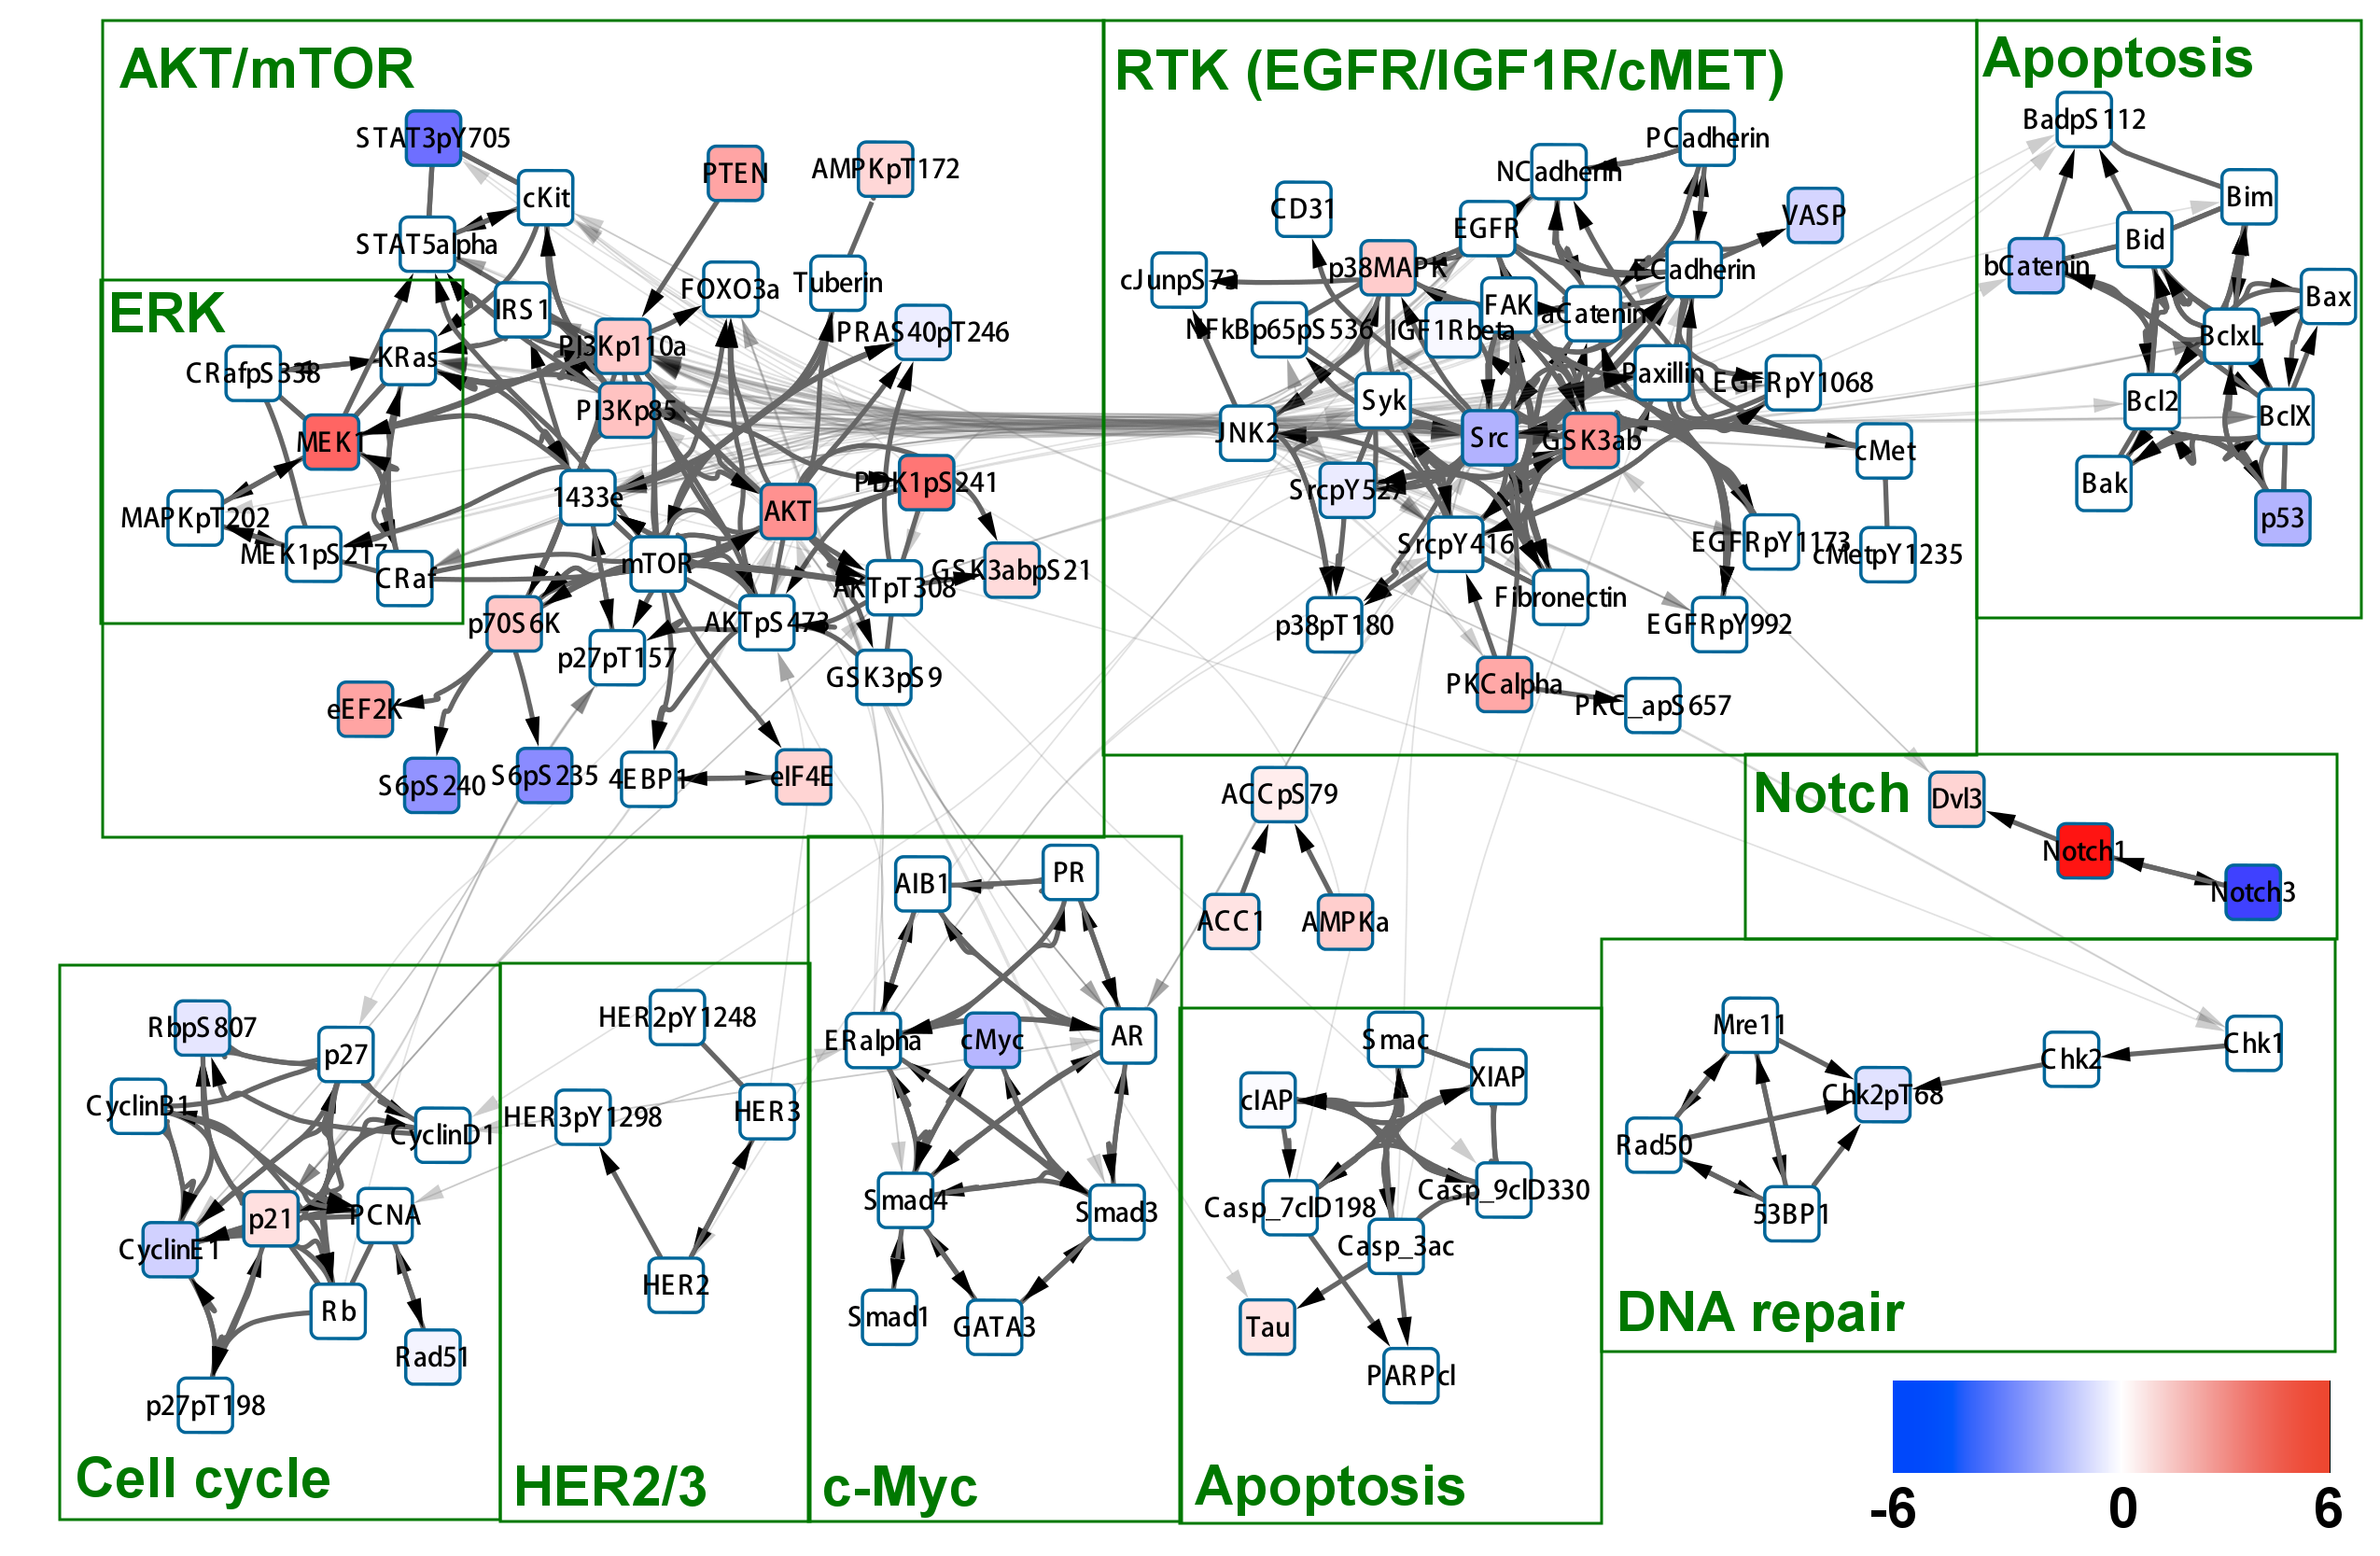
COV318: Resistant
Notes:
Both AKT and RTK pathways are active.
GSK3 level is up.NotCh1 is up.
MEK is substantially up.

Slide 22
Difference map:<cov318-igrov1>
Difference between the readouts for proteomic entities treated with JQ1.
Calculate the difference between response at same drug dose.
ΔPr(di)=Pr^{cl1}(di)-Pr^{cl2}(di)
t-test for Ho: <ΔPr(di)> = 0
If p < 0.05 from t-test map the area under the curve of ΔPr(di) vs. di plot on pathway diagrams.

Slide 23
The COV318 vs. IGROV1 differential response
node | auc(cov318-igrov1) | pval
AKTpS473 | 6.2935 | 1.30E-04
RbpS807 | 5.8445 | 7.51E-05
Notch1 | 5.182 | 1.29E-05
CyclinB1 | 4.892 | 3.38E-04
AMPKpT172 | 4.7445 | 9.18E-04
ACCpS79 | 4.251 | 2.21E-04
GSK3abpS21 | 4.154 | 6.54E-05
S6pS235 | 4.1225 | 8.86E-03
SrcpY416 | 3.916 | 9.96E-04
p70S6KpT389 | 3.8645 | 5.82E-03
MEK1 | 2.828 | 1.88E-06
S6pS240 | 2.81 | 1.91E-02
AKTpT308 | 2.789 | 1.01E-04
AnnexinI | 2.5575 | 5.28E-05
CDK1 | 2.5005 | 9.65E-05
HER3 | 2.485 | 5.53E-06
ACC1 | 2.481 | 2.76E-04
CRafpS338 | 2.156 | 9.75E-05
AMPKa | 2.04 | 6.25E-05
Top 20 proteins.
“The curve:” The plot for the Δ of read out in two cell lines vs drug dose.

Slide 24
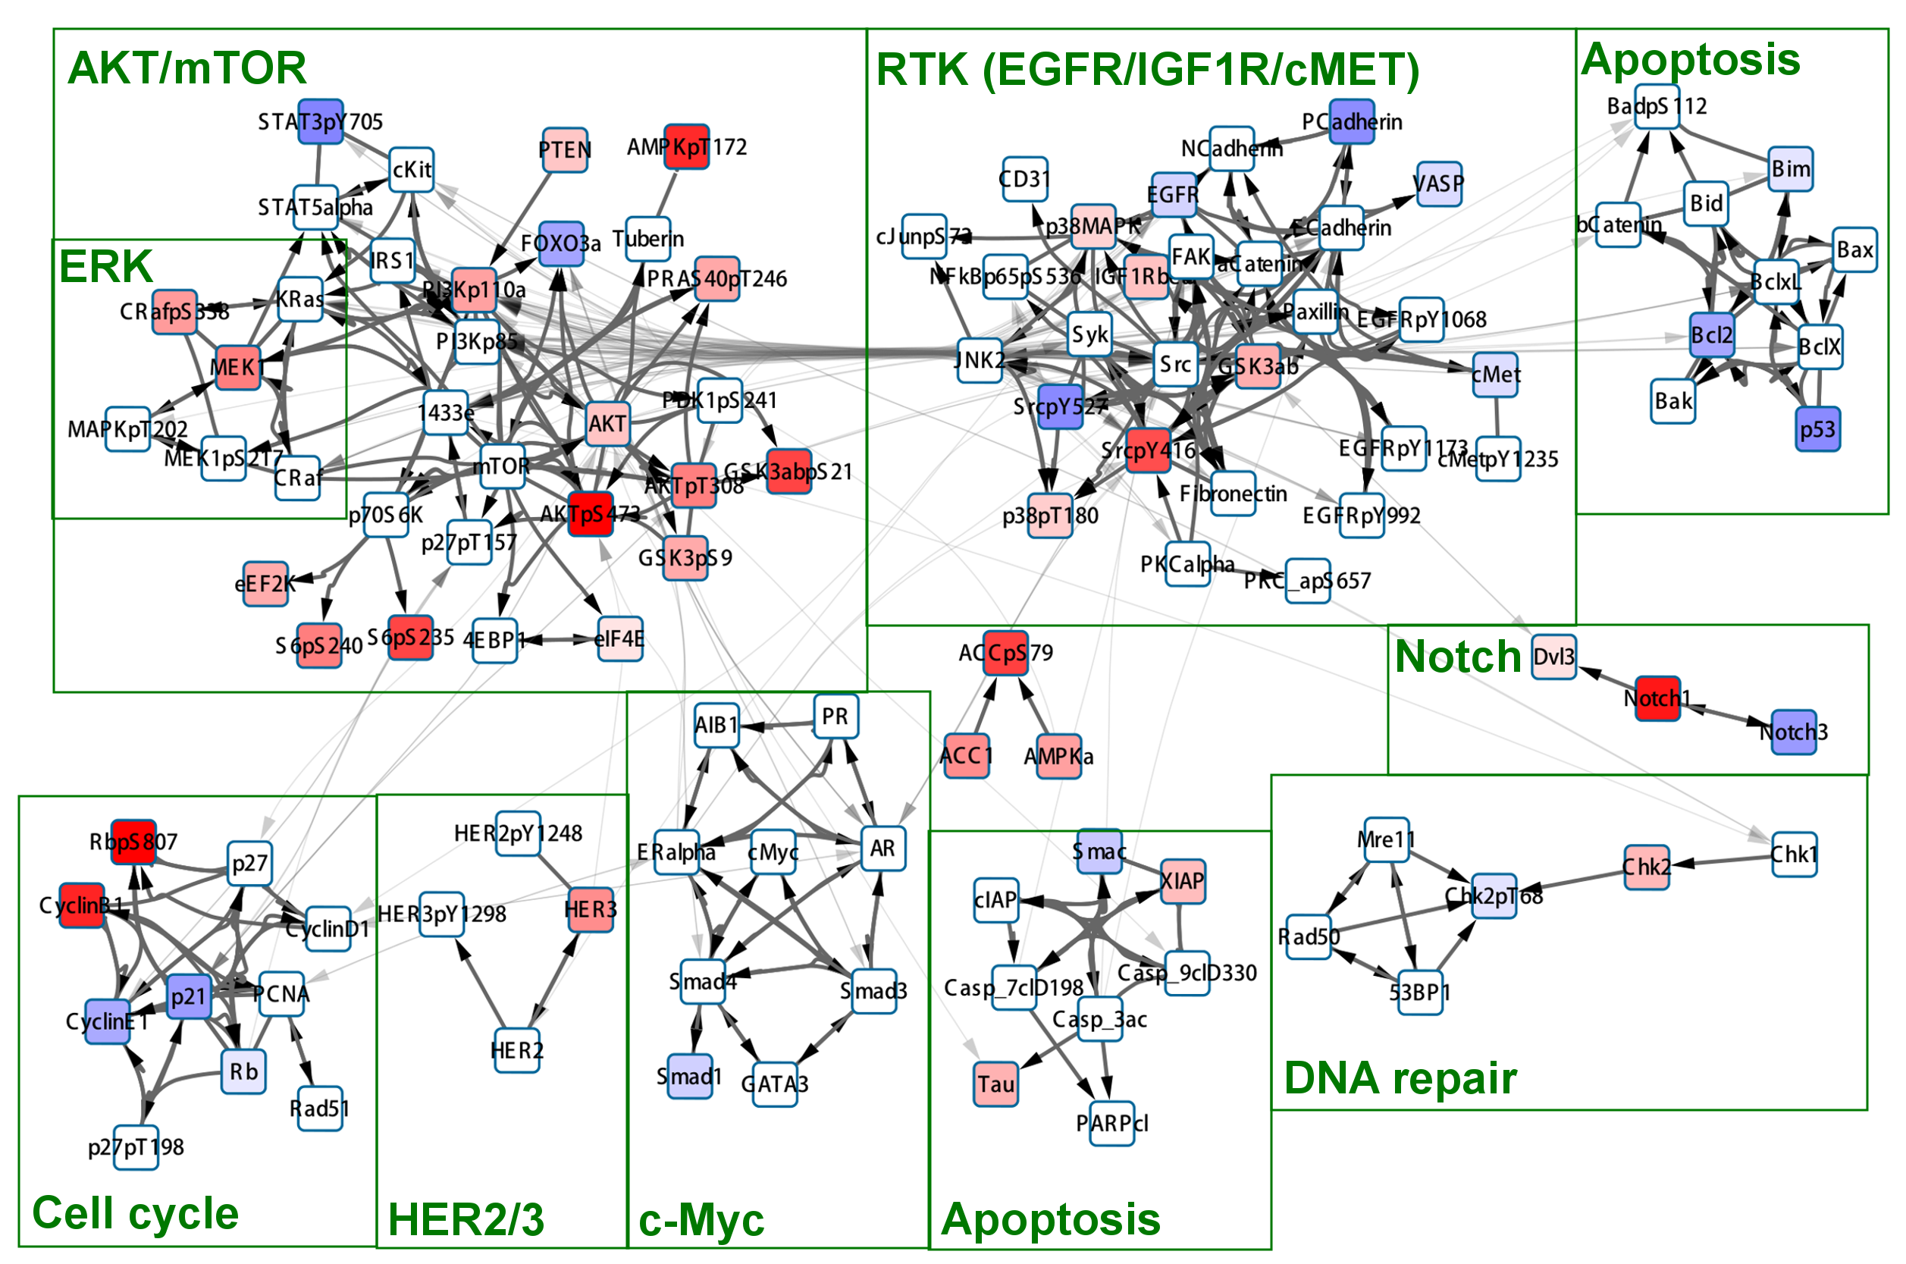
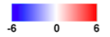
Difference map:<cov318-igrov1>
Drug : JQ1 (0-5uM)

Slide 25
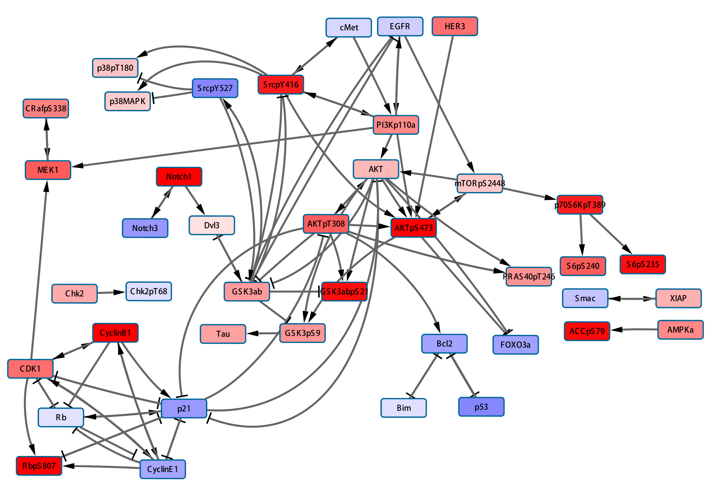
Difference map:<cov318-igrov1>
A pathway diagram of altered proteins

Slide 26
Drug combinations?
(4) Can we nominate a combination to overcome the JQ1 resistance in resistant cell lines.
A simple hypothesis:
-If an level of an oncogenic protein (p-AKT, p-MEK) increases in response to a JQ1,
Its increased level confer resistance. Co-inhibition with JQ1 may lead to synergy.
-If a tumor suppressor protein goes down in response to a drug. Oncogenic proteins in its neighbourhood can be potential co-targets.
-If the level of an oncogenic protein does not decrease in response to JQ1 (while it does so in sensitive lines), it may be a combination partner with JQ1.

Slide 27
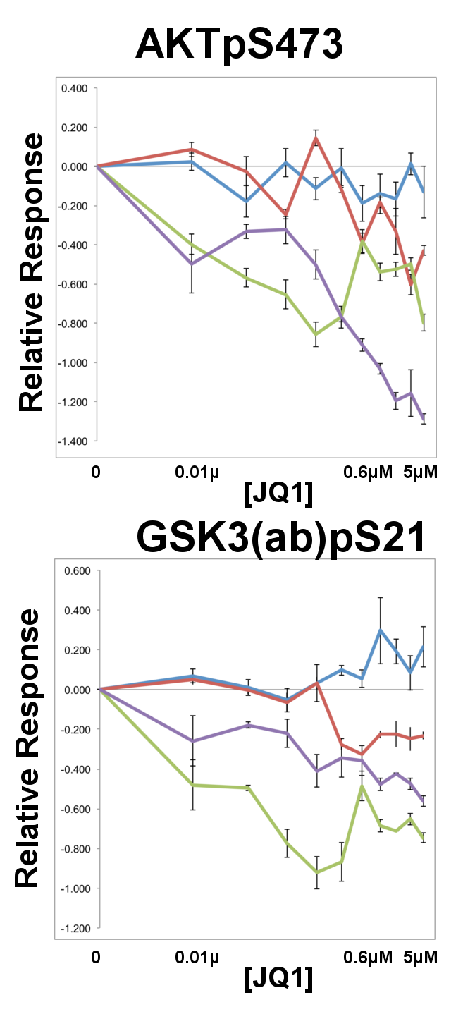
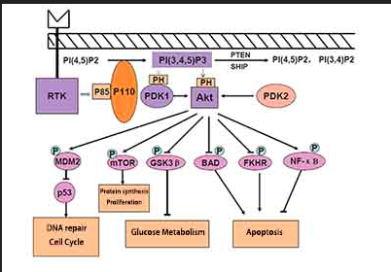
AKT pathway
P-AKT is down-regulated in sensitive IGROV1 in response to JQ1.
P-AKT is unchanged in the resistant OVCAR318.
Other cell lines display intermediate response.
Similar argument holds for p-GSK3. p-GSK3 is upregulated
in response to high dose JQ1 in CAV-318 cells.
JQ1+AKTi

Slide 28
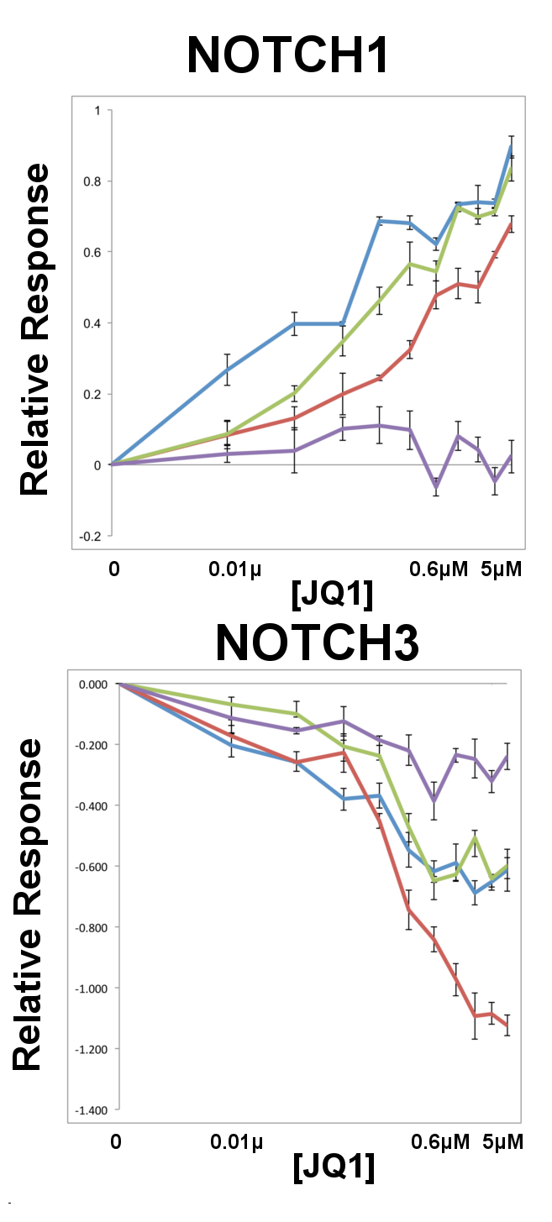
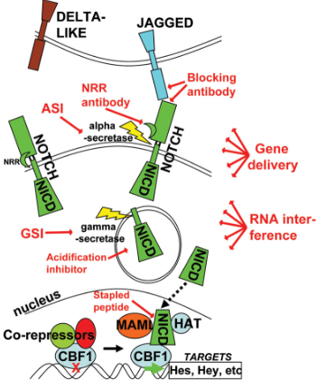
NOTCH pathway
NOTCH1 levels increase substantially in resistant cell lines
but NOTCH3 level is decreased.
No significant effect is observed in sensitive cells.
JQ1+GSI (?)
Already tested in leukemia.
But how about the NOTCH3 level?

Slide 29
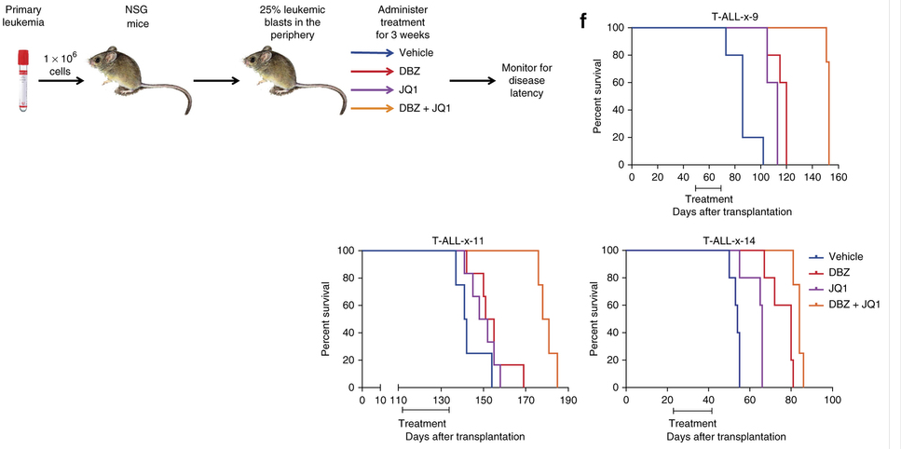
NOTCH inhibition resistance in T cell acute lymphoblastic leukemia.
GSI+JQ1
Knoechel et al 2014

Slide 30
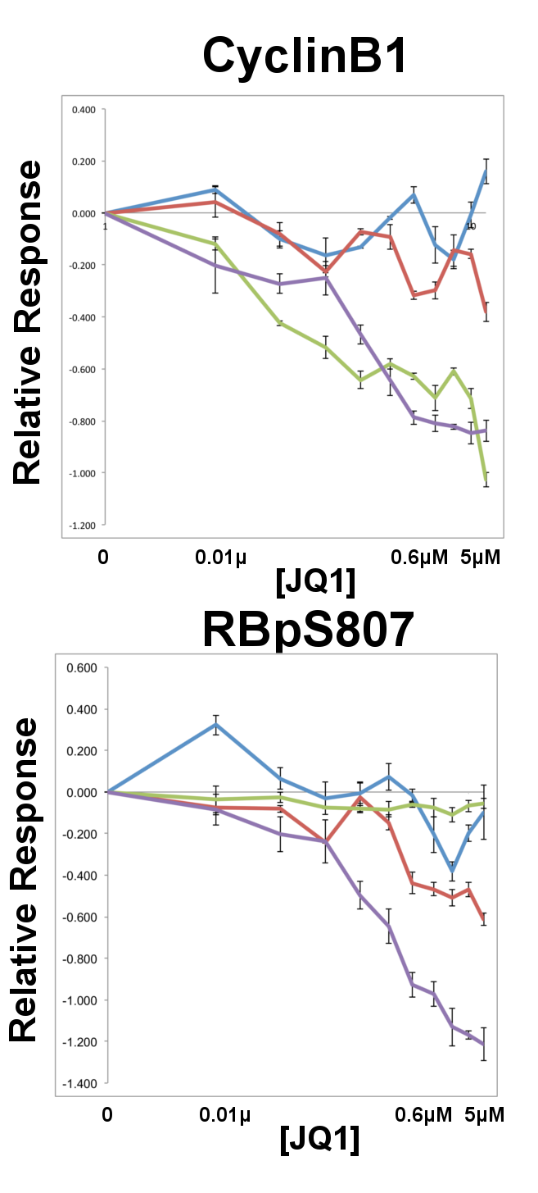
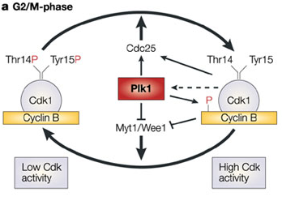
Cell Cycle
CyclinB1 & RBpS807 level is stable in resistant cell line.
JQ1+PLK1i may be an effective strategy.

Slide 31
Work in progress
1. Improvements in pathway analysis
Better representation of phospho data.
Simplification f the diagrams.
Establishing potentially causal links (Emek)
2. Elastic net regression analysis between phenotypic and proteomic response (Augustin Luna)

Slide 32
Thanks
Ozgun-Emek-Arman (pathway analysis-various discussions)
Silvia-Weiqing-Xiaohong (data)
Augustin (Elastic Net)
Chris

Slide 33
Difference map:<cov318-igrov1>
Difference between the readouts for proteomic entities treated with JQ1.
Only use those that give dose dependent response at least in one of the cell lines.
ρ(Pr^{cl1}(di),CV^{cl1} (di)) p<0.05 or ρ(Pr^{cl2}(di),CV^{cl2}(di)) p<0.05
ρ: spearman’s rank correlation
CV=cell viability
PR: proteomic readout
di: drug dose series
cl: cell line
Calculate the difference between response at same drug dose.
ΔPr(di)=Pr^{cl1}(di)-Pr^{cl2}(di)
t-test for Ho: <ΔPr(di)> = 0
If p < 0.05 from t-test map the area under the curve of ΔPr(di) vs. di plot on pathway diagrams.

